Slide 1
Updated Marketing Data for Excel Assignment
Practice assignment on MS Excel
Atul Prajapati_APBADS_12

Slide 2
Business Objective:
Equip marketing professionals with advanced Excel skills to enhance campaign strategy, target marketing efforts effectively, and optimize resource allocation.
The business problem ties together the specific tasks of sorting and filtering data, conditional formatting, and using advanced functions and formulas, reflecting the progression in data handling skills essential for optimizing marketing strategies.

Slide 3
Beginner Level task: Shorting and Filtering Data
Q1. How can the marketing team effectively segment customer data based on demographics?
Task: Use Excel's sorting function to arrange customer data based on age from oldest to youngest.
Task: Filter customer data by location to identify customers from specific geographic regions.
Task: Sort customer data by product interest to understand. Find which product categories are most popular among customers.

Slide 4
Location | Counts location
East | 1191
West | 1225
North | 1261
South | 1321
Categorized age with the customer count.
Mostly customers whose avg age 61 is highest count: 1508.
Product Intrest | Customer Response | Product Count
Books | 25.39% | 1270
Electronics | 24.50% | 1225
fashion | 24.84% | 1242
Home Goods | 25.25% | 1263
 | 5001
Reading books among the customers is most popular
Row Labels | Count of Customer ID | Average of Age
Old | 1310 | 47.44732824
Oldest | 1508 | 61.95092838
Young | 910 | 35.54725275
Youngest | 1272 | 23.91194969

Slide 5
Row Labels | Books | Electronics | Fashion | Home Goods
Old | 352 | 300 | 325 | 333
Oldest | 342 | 409 | 383 | 374
Young | 255 | 230 | 218 | 207
Youngest | 321 | 286 | 316 | 349
After filtering and shorting the data we have done categorizing in the age and do some aggregation function to better understand whether customer data by location to identify customers from specific geographic regions. And we can find easily that which product categories are most popular among the customer.
That product category is “Book” which is the most popular among the customer which count is: 1270 person.

Slide 6
Intermediate Level task:
Conditional Formatting:-
2. Question: How can the marketing team identify regions with high sales performance?
Task: Apply conditional formatting to highlight cells with sales amounts above a certain threshold, indicating high-performing regions.
Task: Use conditional formatting to identify underperforming products by highlighting cells with sales amounts below a certain threshold.
Task: Create a color scale to visualize variations in sales performance across different regions.

Slide 7
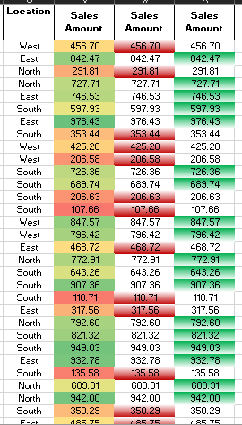
Row Labels | Average of Sales Amount | Sum of Sales Amount2
East | 515.1166163 | 23.48%
North | 531.0501824 | 25.63%
South | 517.7504384 | 26.22%
West | 526.3153796 | 24.68%
we have 3 column of sales amount. In 1st column shows 3 color combination green, red and yellow. Red color represent data which is the lowest value in the cell and yellow represent data mid point value in the cells which have 50th percentile and green color represent the highest value in the cell.
In the second column those value have been colored by red which is representing the below from the average.
In the 3rd column those value have been colored by green. it means the value in those cells have above from the average.
All the task is done by using conditional formatting.
Identified that in region north which have high sales performance .

Slide 8
Intermediate Level task:
3. Question: What are the key metrics that indicate campaign success or failure?
Task: Apply conditional formatting to highlight cells where the campaign response is "Yes," indicating a positive response.
Task: Calculate the average ROI for different marketing channels to assess their effectiveness in generating returns.
Task: Use conditional formatting to identify customers with high purchase frequency, indicating strong engagement with marketing efforts.
In this task have also used conditional formatting for retrieving the data, analysis and all those things.

Slide 9
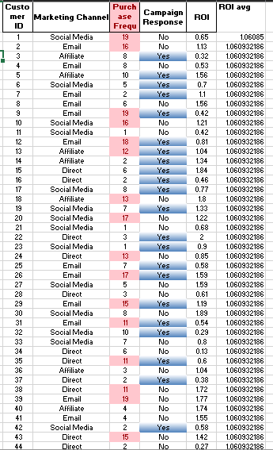
In the purchase frequency column those value have been highlighted which is high. To indicate strong engagement with marketing efforts.
Highlighted cells where the campaign response is "Yes," indicating a positive response.
Row Labels | Average of ROI | Average of Purchase Frequency
Affiliate | 1.058207946 | 10.01606086
Direct | 1.055309446 | 10.16856678
Email | 1.067203647 | 9.659574468
Social Media | 1.062081697 | 9.894736842
Purchase frequency(10.16) of the customer is high through using the channel “Direct”.
ROI is through “Email” is highest 1.067 and 2nd is “Social Media”

Slide 10
Row Labels | Average of ROI | Count of Customer ID
Affiliate
No | 1.075712025 | 632
Yes | 1.038130672 | 551
Direct
No | 1.056678508 | 563
Yes | 1.054150376 | 665
Email
No | 1.054525223 | 674
Yes | 1.080514019 | 642
Social Media
No | 1.042351145 | 655
Yes | 1.082993528 | 618
Campaigning response of the customers :
Yes : 2476
No : 2524
Avg of ROI is high for email.

Slide 11
Advance Level task:
Use:-
Advanced Functions and Formulas
4. Question: How can the marketing team calculate the customer lifetime value (CLV) to prioritize high-value customers?
Task: Use available data to segment customers into high, medium, and low based on their purchase frequency (pf). (pf <= 5 as low , pf >5 and pf <= 15 as medium , pf> 15 as high).
Task: Use available data to segment customers into high, medium, and low based on their transaction value(tv). (tv <= 50 as low , tv >50 and tv <= 150 as medium , tv> 150 as high).
Task: Use available data to segment customers into high, medium, and low based on their Sales Amount (sa). (sa <= 350 as low , sa >350 and sa <= 650 as medium , sa> 650 as high).
Task: Combine these data on purchase frequency, transaction value, and sales amount to compute the CLV for each customer.
Business Problem: The marketing company needs to calculate complex metrics like customer lifetime value and return on investment for various campaigns.

Slide 12
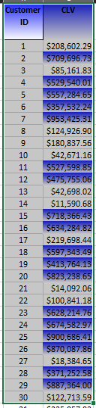
We have use “IF” function for retrieve High, medium and low value from column sales amount(sa), purchase frequency(pf) and transaction value(tv).
CLV(customer lifetime value) Calculations for each customer: sa * pf * tv
Highlight cells indicates the customer lifetime value is high.
Average CLV : 348532
Maximum CLV : 999930
Minimum CLV : 2501.5

Slide 13
Advance Level task:
5. Question: How can the marketing team analyze the effectiveness of different marketing channels in generating ROI?
Task: Use the VLOOKUP function to retrieve ROI values for high-value CLV customers based on the marketing channel they were acquired through.
Task: Calculate the total ROI for each marketing channel to identify the most lucrative channels.
Task: Use conditional formatting to highlight cells where ROI exceeds a predefined threshold, indicating successful marketing channels.

Slide 14
Row Labels | Sum of ROI
Affiliate | 1250.82
Direct | 1295.92
Email | 1405.48
Social Media | 1352.03
Row Labels | Sum of ROI
April | 448.43
August | 465.39
December | 426.7
February | 425.45
January | 463.47
July | 449.55
June | 448.62
March | 466.36
May | 455.13
November | 414.57
October | 420.8
September | 419.78
The most lucrative channel is "Email" which value is : 1405.48.
The 2nd One is "Social Media" which value is = 1352.03.

Slide 15
Advance Level task:
6. Question: What factors contribute to customer satisfaction and how does it impact sales performance?
Task: Calculate the correlation coefficient between customer satisfaction scores and sales amount to assess the relationship.
Task: Use conditional formatting to highlight cells where customer satisfaction scores are low, indicating potential areas for improvement.
Task: Analyze the average sales amount for customers with different satisfaction scores to identify trends.
Conditional formatting applied on customer satisfaction score and highlighted those cell who gives score below of threshold.

Slide 16
Row Labels | Sum of Sales Amount | Sum of Correlation coefficient
1 | 534595.53 | 6.762797632
2 | 506342.65 | 6.521747419
3 | 513959.25 | 6.816364345
4 | 539487.3 | 6.86323522
5 | 518493.61 | 6.51505158
The Correlation coefficient between csat score and sales amount is:
Given score is : 4 which have highest sales amount "539487.03" with strong correlation coefficient which is "6.86".

Slide 17
Average of Sales Amount | Column Labels
Row Labels | 1 | 2 | 3 | 4 | 5
April | 602.7124096 | 515.9067677 | 524.5632468 | 537.9092683 | 550.6473418
August | 543.723375 | 528.6090361 | 473.4580899 | 518.8290323 | 542.0501124
December | 535.1585135 | 555.1477143 | 483.5663095 | 517.6853608 | 557.2225641
February | 557.4368293 | 541.9357317 | 475.9660714 | 523.0558904 | 531.7432432
January | 546.500566 | 485.0388889 | 486.2579012 | 516.692619 | 561.5643836
July | 521.8493258 | 482.0980488 | 514.4915625 | 554.2391765 | 523.3971951
June | 526.45 | 528.4822826 | 538.8532967 | 485.8245205 | 493.0794186
March | 469.0893814 | 537.1256164 | 453.8669318 | 543.3369767 | 550.6632222
May | 532.6367045 | 516.6988506 | 532.3495745 | 518.5198795 | 558.3681707
November | 530.4268919 | 503.9768571 | 489.1580233 | 550.7470513 | 485.7596341
October | 495.1209877 | 517.315 | 591.2850746 | 503.5930392 | 492.1587356
September | 494.7966667 | 533.802625 | 510.5039506 | 546.7695506 | 558.085493
Average sales amount for customers over trends with month wise by their satisfaction score.
Analysis is: In "April month" customers have highest avg sales amount : 545.47
And the csat score for highest avg sales amount which is 602.71 is : 1 which is very low score.
2nd One have also high avg sales amount which is: 528.66 which value have in "September"

Slide 18
Conclusion: 1. We have three level of analysis Beginner, Intermediate and High. 2. Organize and categorize customers needs into meaningful demographic groups. 3. Enhance customer engagement through tailored strategies. 4. Customers should be enhanced engagement through tailor strategies. 5. Customer should be personalized campaign that resonates with specific segments.
Thank You
Email: user.atul@yahoo.com
Name: Atul Prajapati
Batch: APBADS_12

